Slide 1
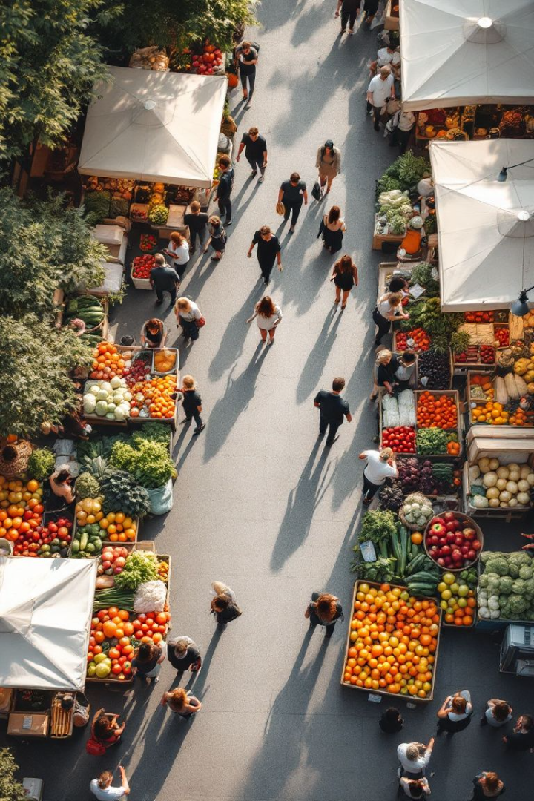
Food Redistribution Interface
Globally, vast amounts of food are wasted. Yet, many face food insecurity. Food redistribution can bridge this gap. Our presentation introduces an interface designed to connect surplus food with those in need, revolutionizing food security.

Slide 2
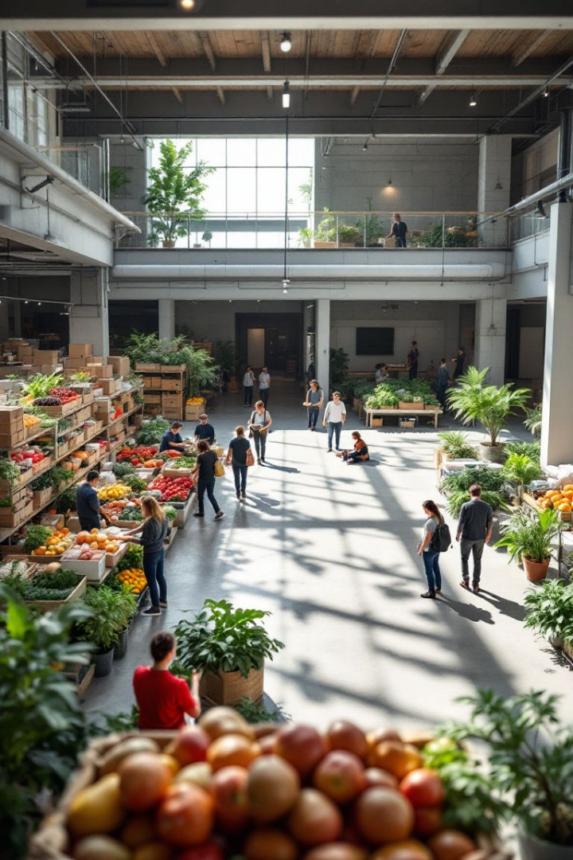



Existing Food Redistribution Systems
Existing systems face limitations. Logistical challenges and lack of real-time inventory visibility are issues. Food banks, soup kitchens, and direct-to-consumer models exist. However, a more comprehensive solution is needed.
Food banks
Soup kitchens
Provide meals
Dependent on volunteers
Imperfect Foods
Focus on produce

Slide 3
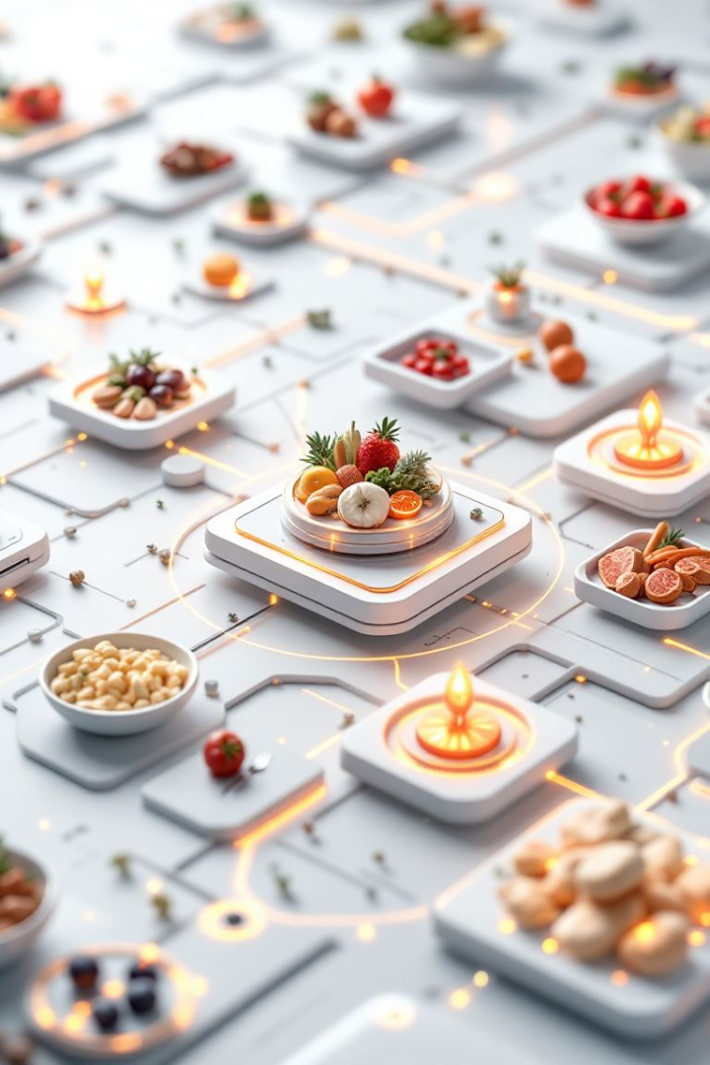


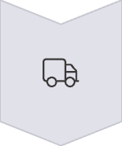
A Food Redistribution Interface
Our platform connects businesses with surplus food to organizations in need. Restaurants and farms list available food in real-time. A matching algorithm connects donors with recipients. Integrated delivery services ensure efficient transportation.
Real-time inventory
Matching algorithm
Transportation

Slide 4
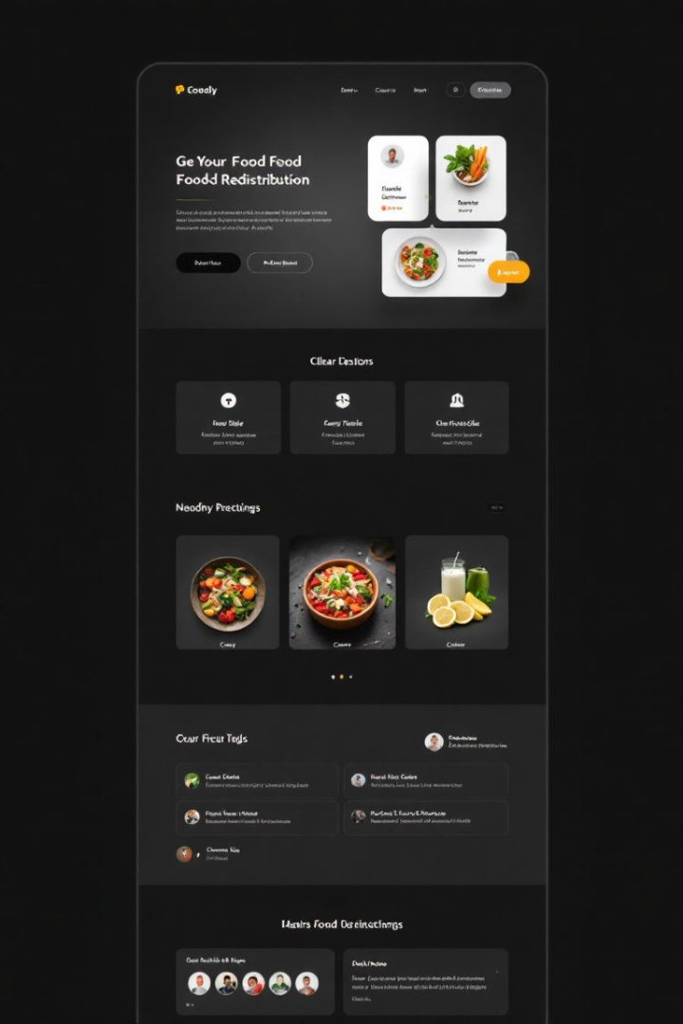
Key Requirements for the Interface
Our interface prioritizes user-friendliness for both donors and recipients. Secure data management ensures food safety and traceability. Location-based search and mobile access are essential. Integration with existing databases is crucial.
User-friendly
Secure data
Easy for all users
Ensure food safety
Location based
Find nearby options

Slide 5




Implementation: System Architecture
Our system architecture leverages cloud infrastructure. Donors, the interface, and recipients share data. A relational database stores food listings and user profiles. APIs and mobile frameworks ensure accessibility.
Cloud
1
Database
Infrastructure
2
Storage
Mobile
4
APIs
3
Access
Connections

Slide 6
Visualizing the Output
Donor dashboards offer food listing options. Recipient dashboards display available food and delivery scheduling. Mobile apps provide navigation and delivery confirmation. These visuals enhance usability and efficiency.
Donor dashboard
Recipient dashboard
Listing options
Delivery scheduling

Slide 7
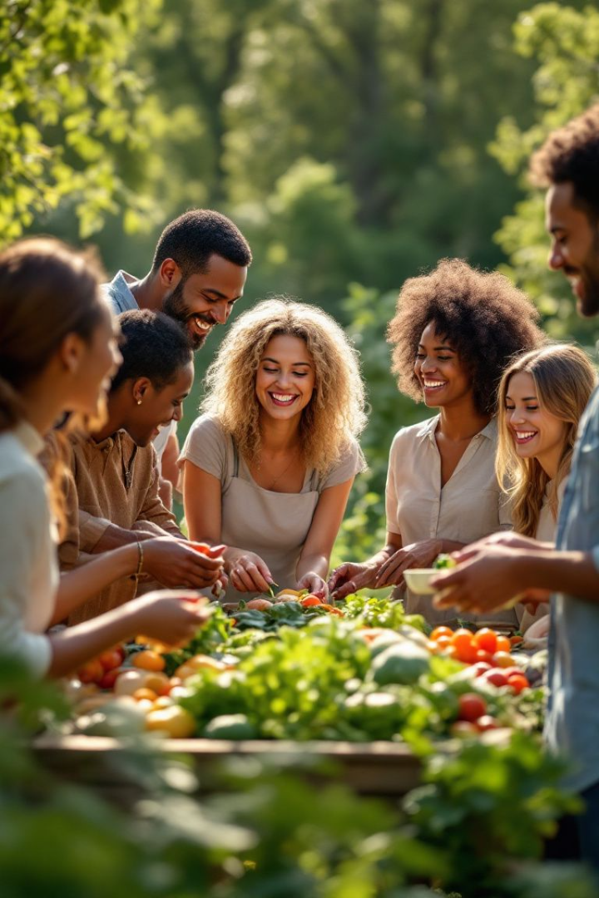



Advantages of the Food Redistribution Interface
Our interface reduces food waste and increases food access. Businesses save on disposal fees. Environmental benefits include lower emissions. We aim for community impact and collaboration.
Reduce Waste
Increase Access
Cost Savings

Slide 8



Conclusion: A Solution
Our interface offers a scalable solution. We can combat food waste and hunger by connecting surplus food with those in need. Participate in our platform and support food redistribution efforts. Together, we can create a sustainable food system.
1
Sustainable Food
2
Reduce Hunger
3
Combat Waste

